Slide 1
Deep Fake Detector
X-Radiant Presents FaceSham

Slide 2
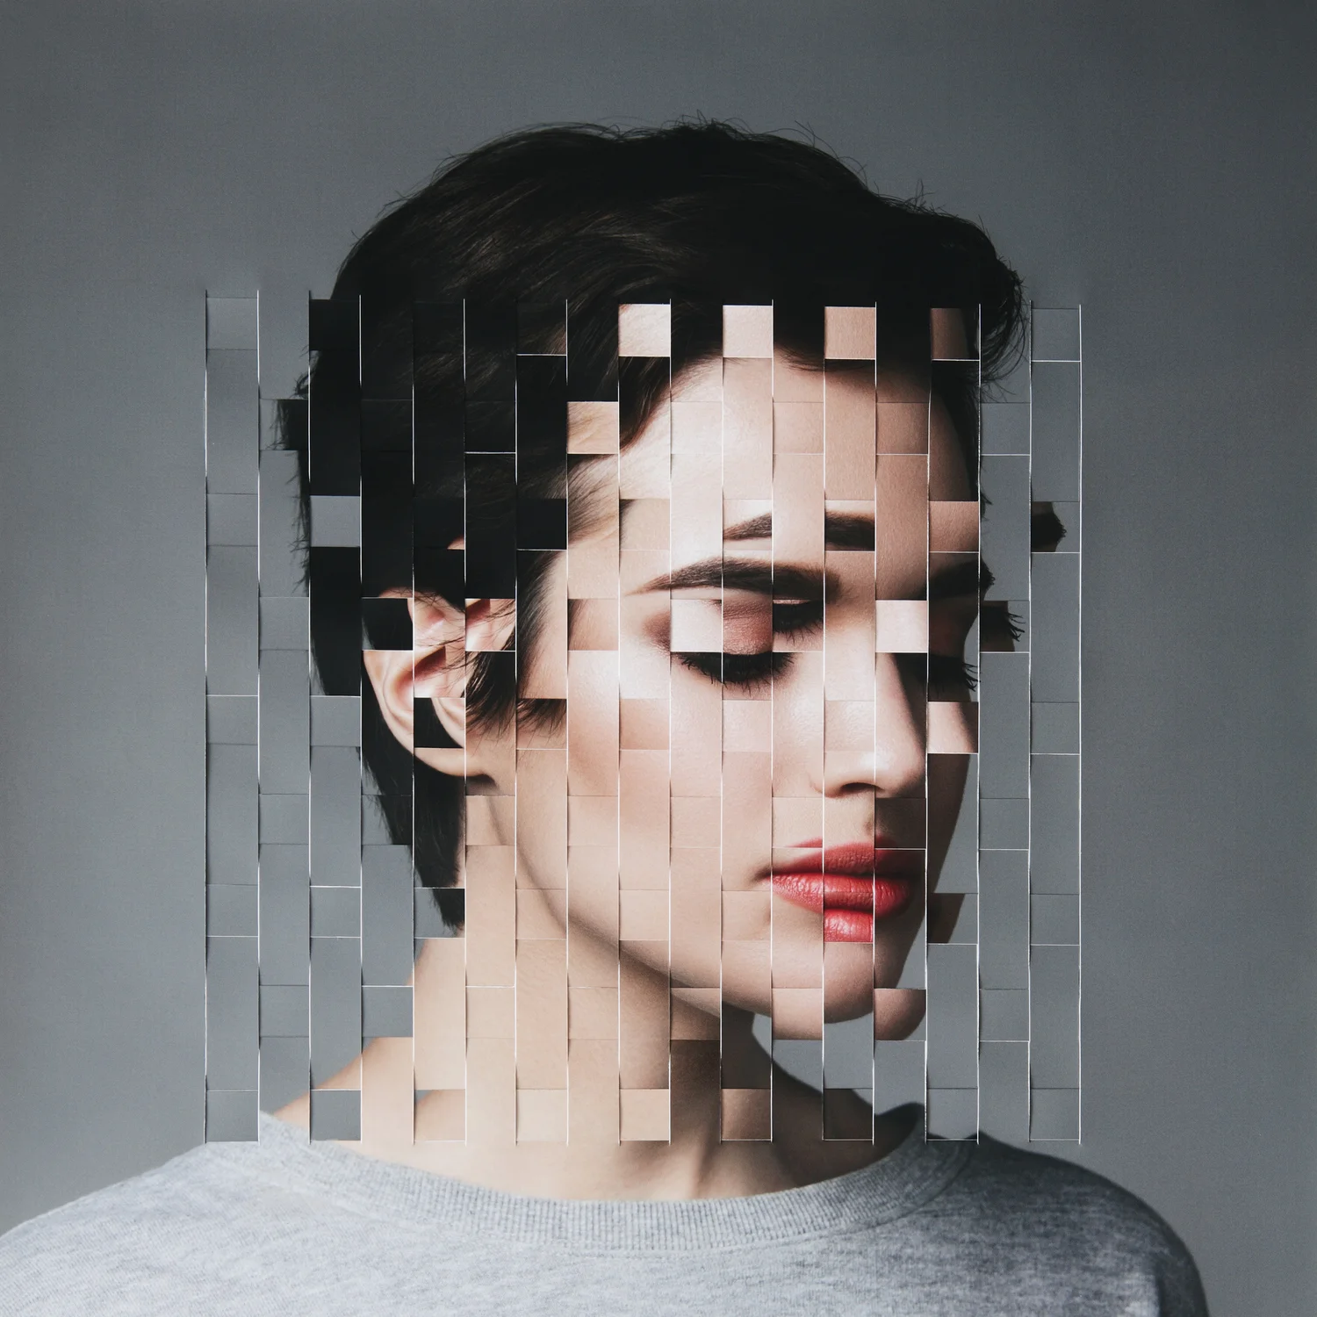
What is DeepFake?
Deepfakes are based on AI technology which creates seemingly realistic but fake images or videos of targeted people by swapping their faces with another person saying or doing things that are not actually done by them.
Deep learning + Fake = DeepFake

Slide 3
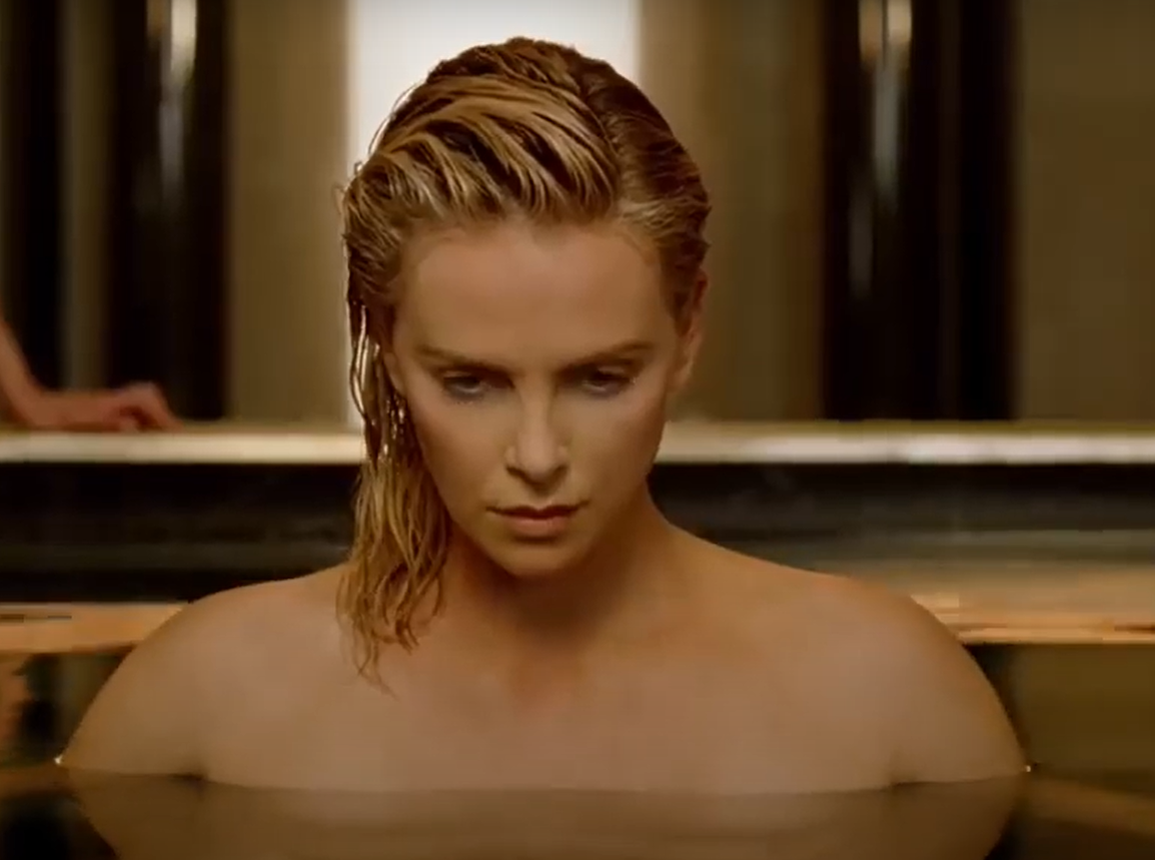

Examples
Original Image
A driving video is used as base input for generating same facial effects on other images.
DeepFake Image
Notes:
These footages may look realistic as well as benign right now but when attached with audio, it may create false representations of the concerned person especially in politics.

Slide 4
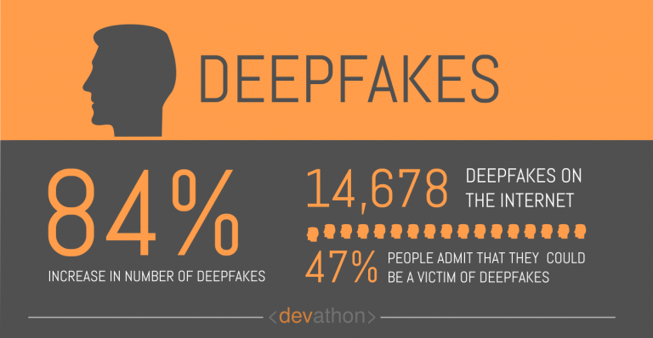
Why DeepFake Detection?
DeepFake detection is imperative because :
Proliferating of fake content is possible on social Media
Fake content creates nuisance in politics as well as any person’s personal life.
It Deceives us in believing things which are Sham.
The value of original content deteriorates.
Difficult for a layperson to identify a DeepFake content and assess its authenticity.
Notes:
If we see and hear something with our own eyes and ears, we believe it to exist or to be true, even if it is unlikely. The brain’s visual system can be targeted for misperception, in the same way optical illusions and bistable figures trick our brains
Social media is the most vulnerable place to spread fake contents. Ex: Whatsapp, Instagram & Youtube.
Unless until monitored properly,

Slide 5
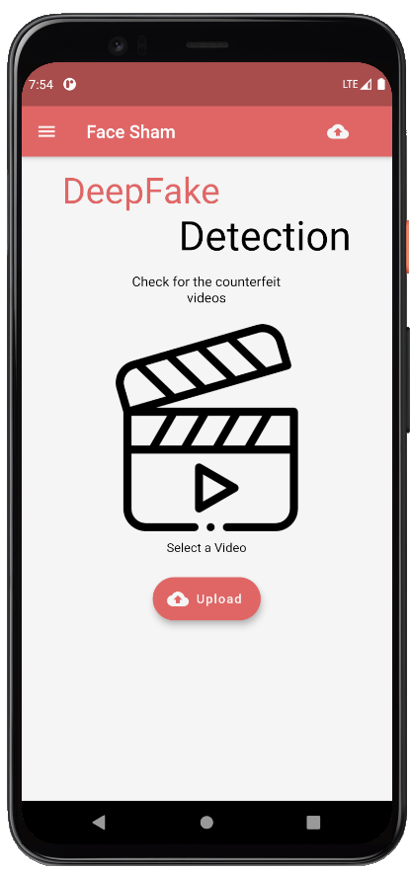
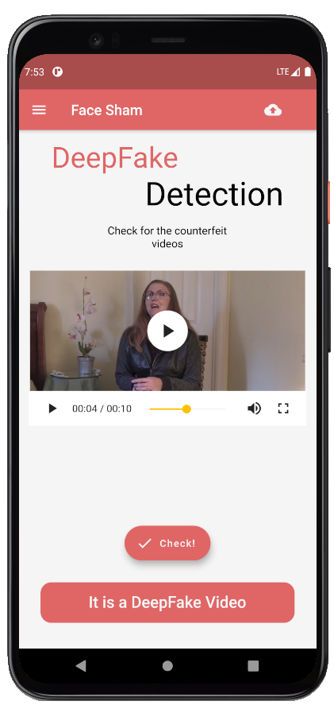
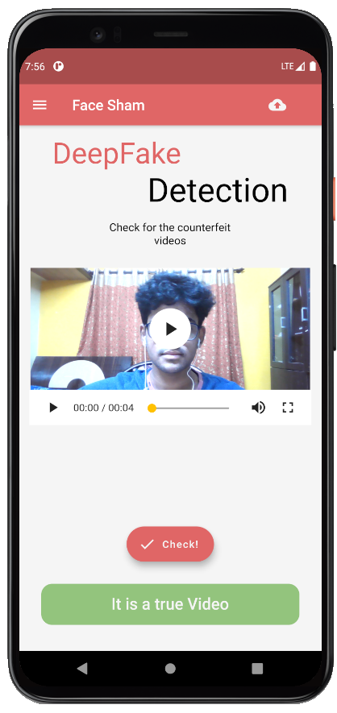
Introducing you FaceSham
Notes:
These footages may look realistic as well as benign right now but when attached with audio, it may create false representations of the concerned person especially in politics.

Slide 6
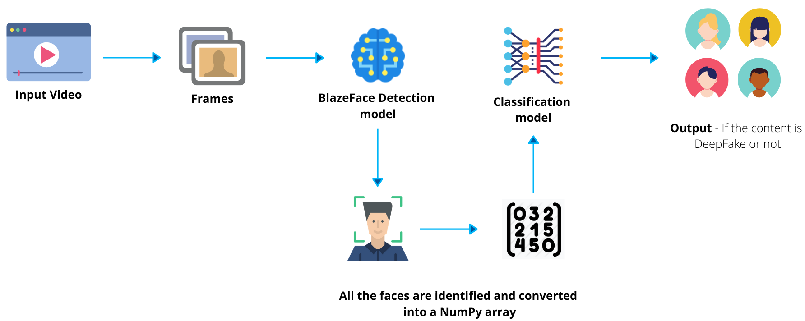
Deep Learning Pipeline
Notes:
These footages may look realistic as well as benign right now but when attached with audio, it may create false representations of the concerned person especially in politics.

Slide 7
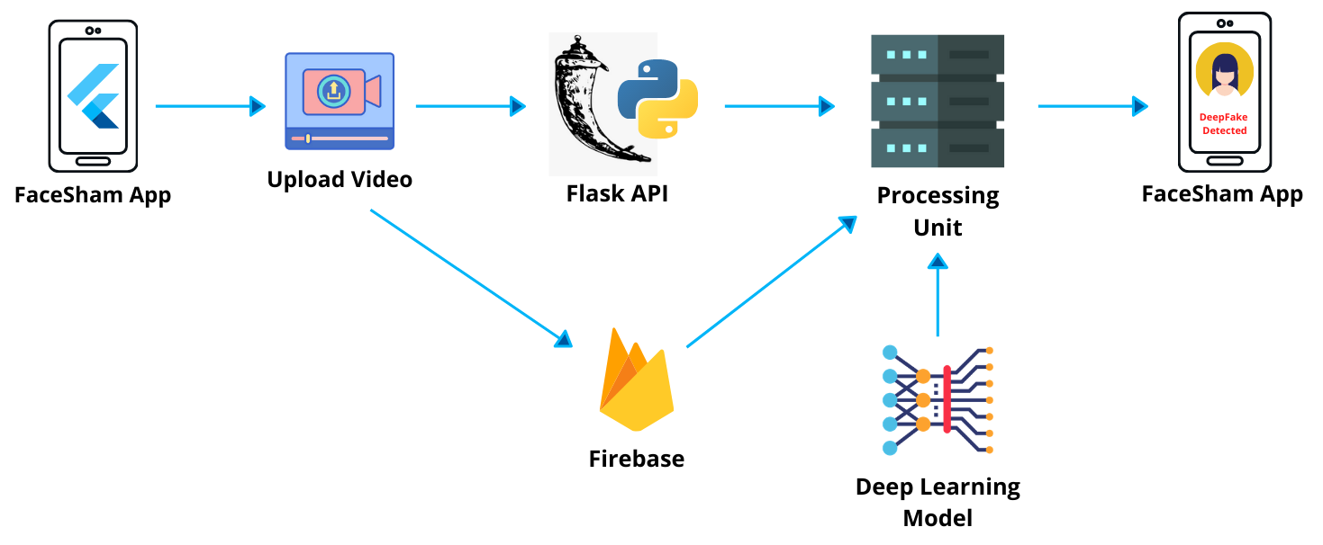
FaceSham App Flow
Notes:
These footages may look realistic as well as benign right now but when attached with audio, it may create false representations of the concerned person especially in politics.

Slide 8
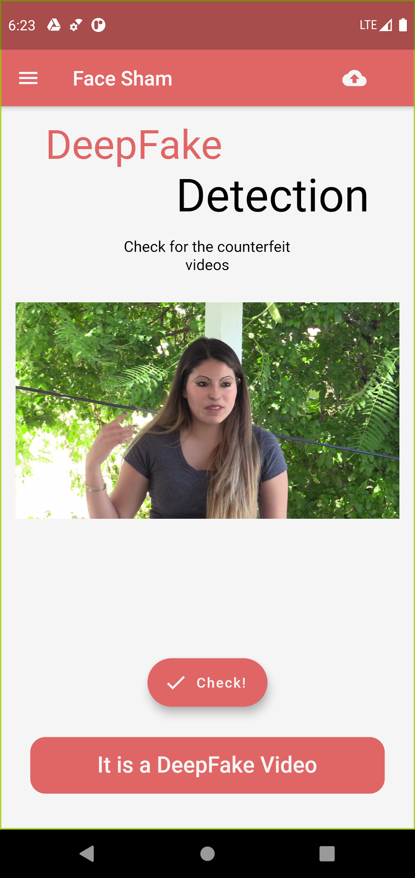
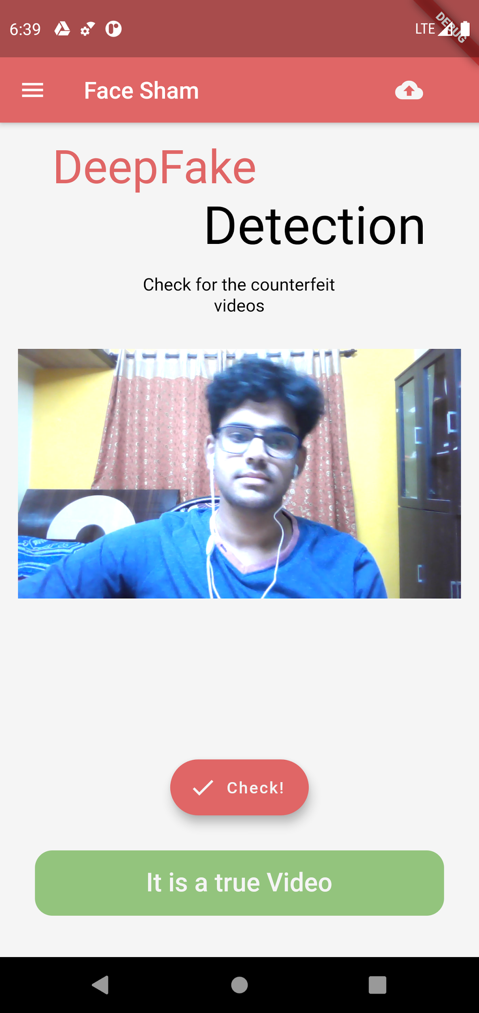
FaceSham UI
User Friendly
Real-time Cloud-based processing
Android as well as iOS
Flutter makes the app more adaptable
Api based , Later on can be integrated with website
DeepFake content is detected
Authentic Video is
detected

Slide 9




The Team Behind FaceSham
Vignesh Charan
Deep Learning Expert | Flutter Developer
Poojan Panchal
ML/AI Expert |
Back-End Lead
Sanskar Garodia
Flutter Developer | Front-End Lead

